Slide 1

One Codebase Three Platforms An Introduction to Xamarin.Forms
Barkley Hughes
Software Engineer
Carlo Wahlstedt
Software Engineer

Slide 2



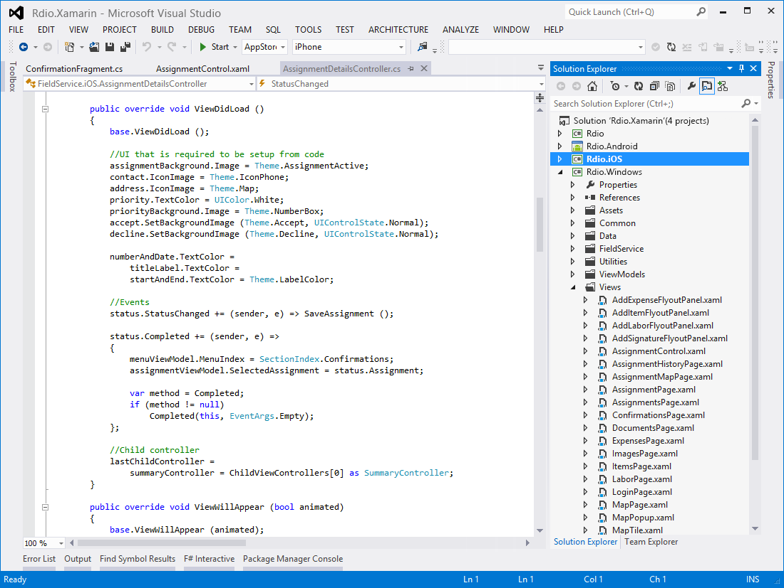
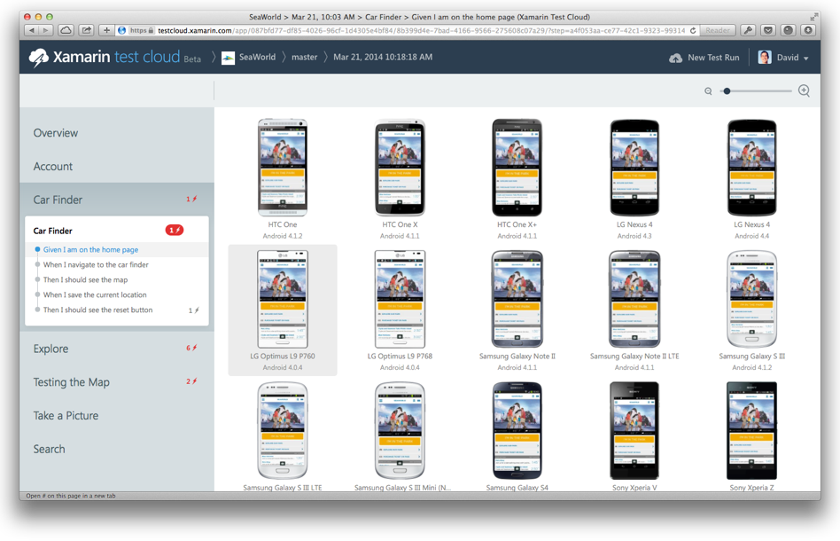
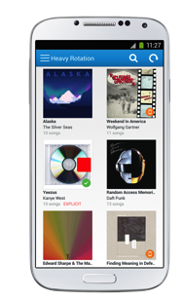
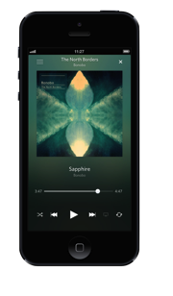
Create native iOS, Android, Mac and
Windows apps in Visual Studio and C#
Automatically test your app on
hundreds of mobile devices
Notes:
If you are new to Xamarin you should know that Xamarin offers a few products.
First is the Xamarin Platform. This is what we will be talking about to today and is where we will be creating native iOS, Android, and Windows apps all in C#.
Second, is a new product called Xamarin Test Cloud. Test Cloud is a unique UI automated testing platform where you are able to create UI tests that run on hundred of physical iOS and Android devices in Xamarin’s test cloud. What is wonderful is that the Test Cloud is open to any iOS or Android mobile app regardless of what programming language or platform it was developed in.

Slide 3
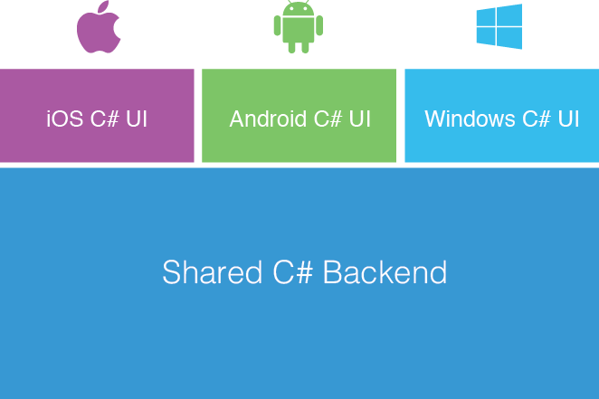
Xamarin’s Unique Approach
Native With
Code Sharing
Business Layer
Notes:
Xamarin’s unique approach enables developers to develop native iOS, Android, and Windows app while creating a shared C# backend (business logic).
You are able to leverage all of your favorite C# features such as async/await, lambas, LINQ, events, delegates, and of course the great .NET Libraries.
Traditionally, with Xamarin you will create a native UI for each platform accessing all of their native controls and native APIs. This development approach can enable you to share on average of 70% of code across all platforms.
We are going to take a look at Xamarin.Forms today, which enables you to share more code, but let’s take a look at what Xamarin development looks like.

Slide 4
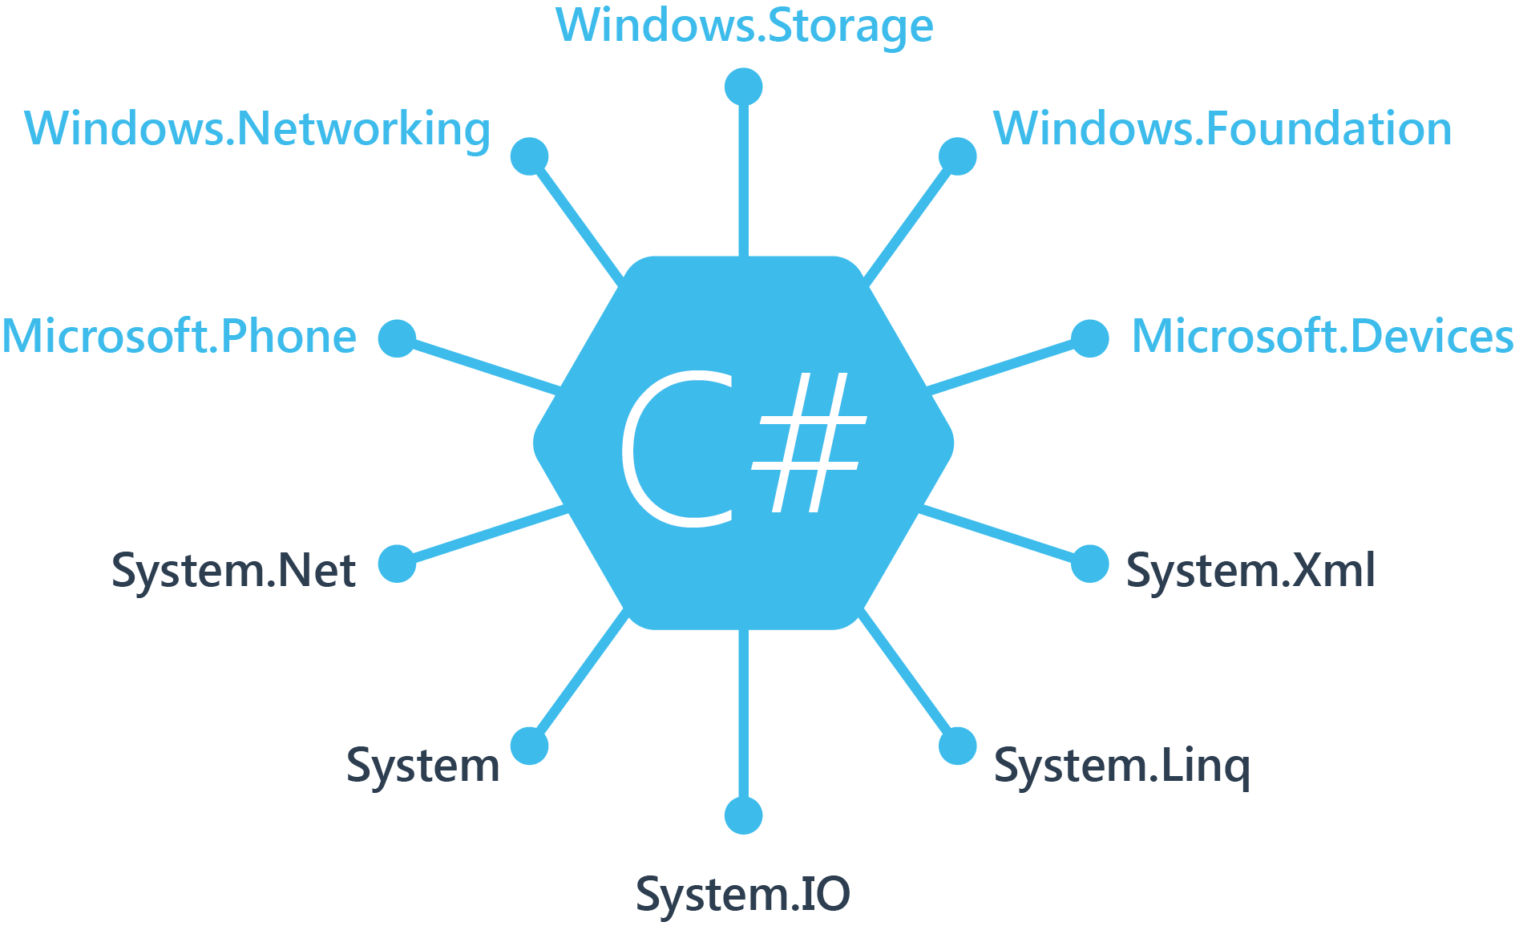
Windows APIs
Notes:
If you have ever developed for a Windows Platform before these .NET namespaces might look familiar.
However, if we go to a new platform such as Windows Phone or Store we have a new SDK to use and a new set of namespaces.

Slide 5
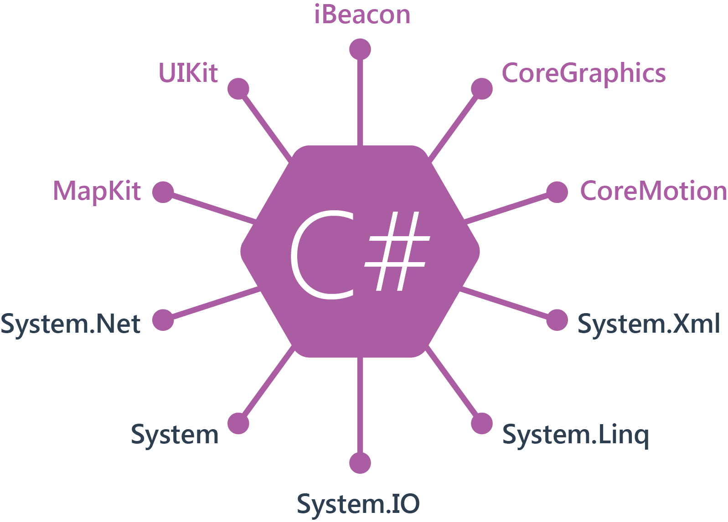
iOS APIs | 100% Coverage
Notes:
You can think of iOS and Android development the same with Xamarin. You can see we have all of our .NET namespaces and libraries, but Xamarin give us 100% api coverage of each iOS API in it’s SDK that we access view C#.

Slide 6
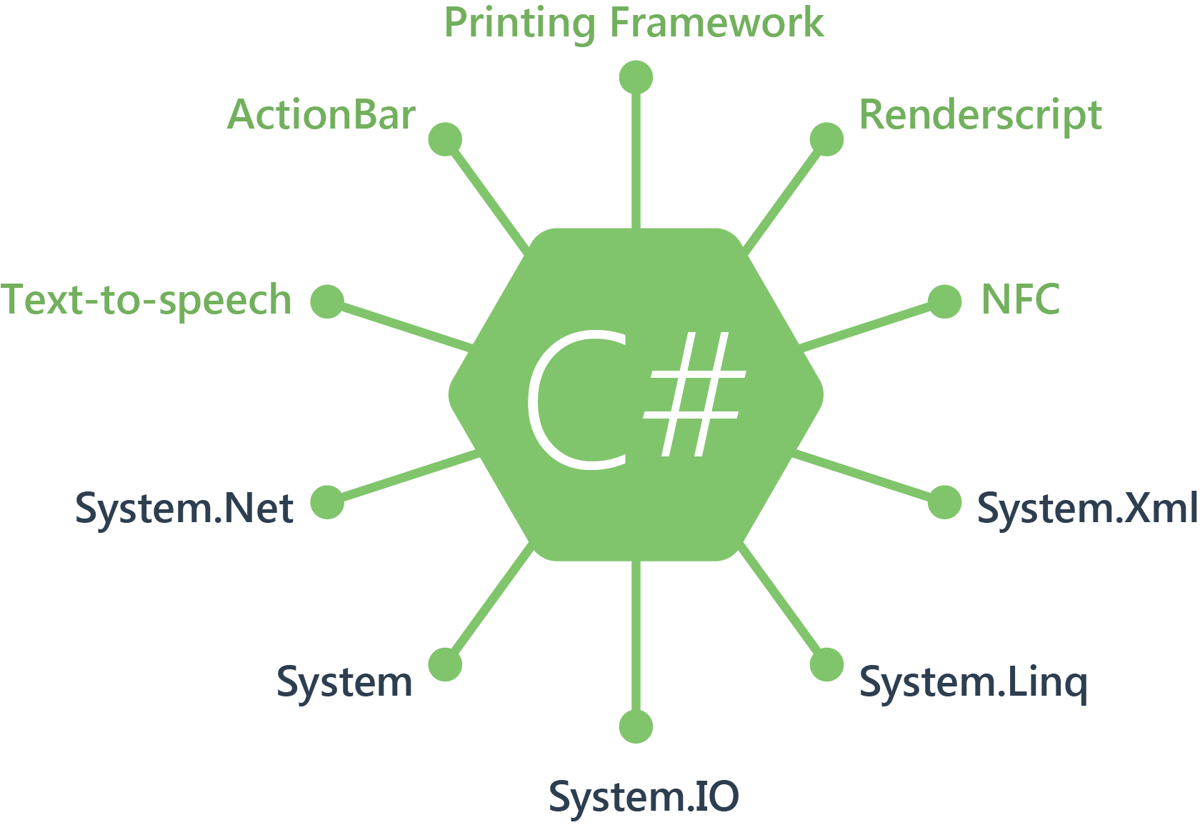
Android APIs | 100% Coverage
Notes:
The same is true for Android as well.

Slide 7
Anything you can do in Objective-C, Swift, or Java can be done in C# with Xamarin using Visual Studio

Slide 8
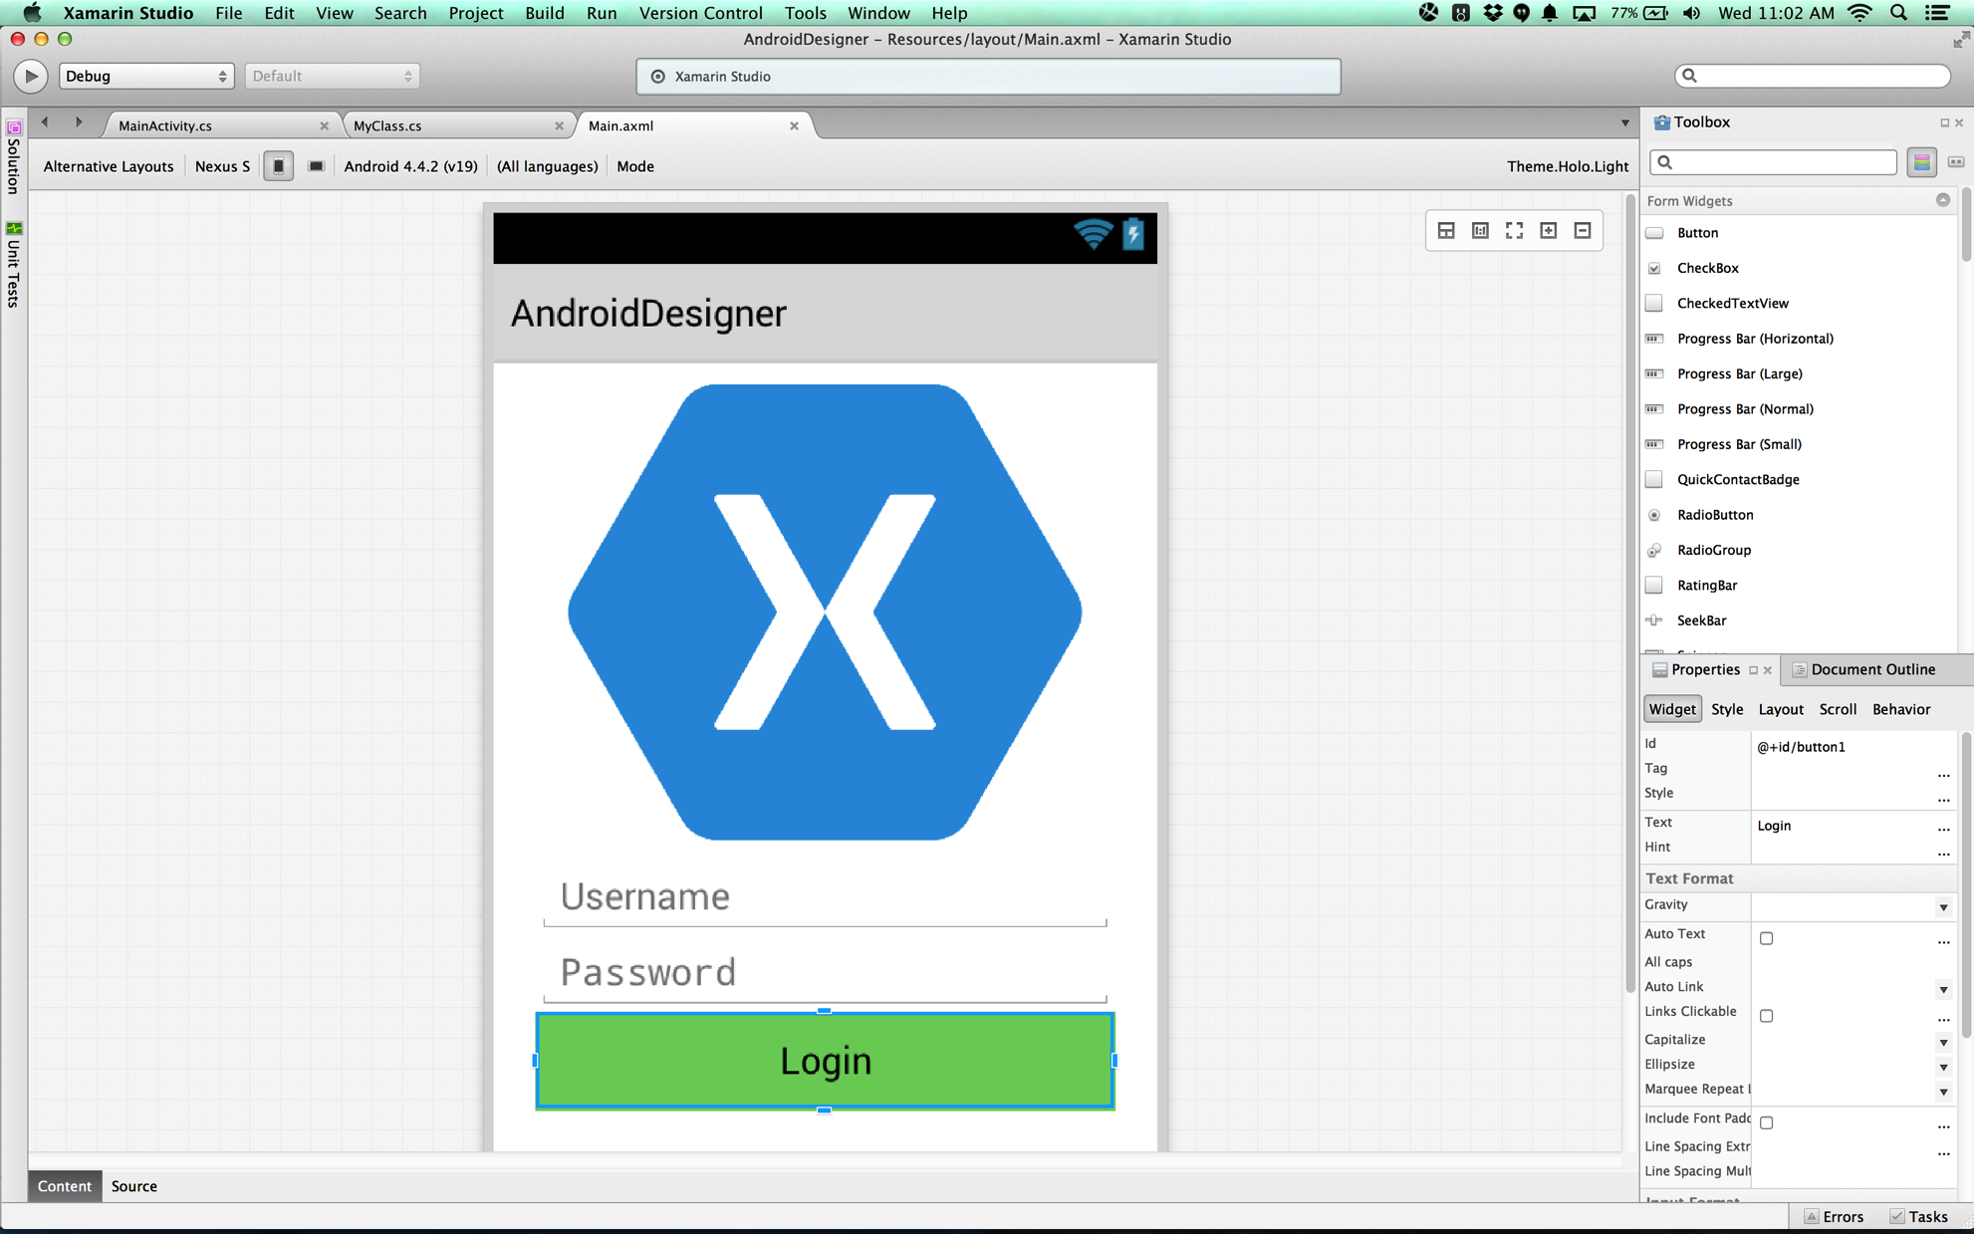
Xamarin Designer for Android
Fully integrated into Xamarin Studio & Visual Studio
Multi-resolution editing
Easy switch between design and Android XML
Shipping for over 2 years
Notes:
If you didn’t know Xamarin has shipped an Android designer for over 2 years
In both Visual Studio and Xamarin Studio
Features multi-layout view editing to make it easy to design for phone, small tablet, and large tablets

Slide 9
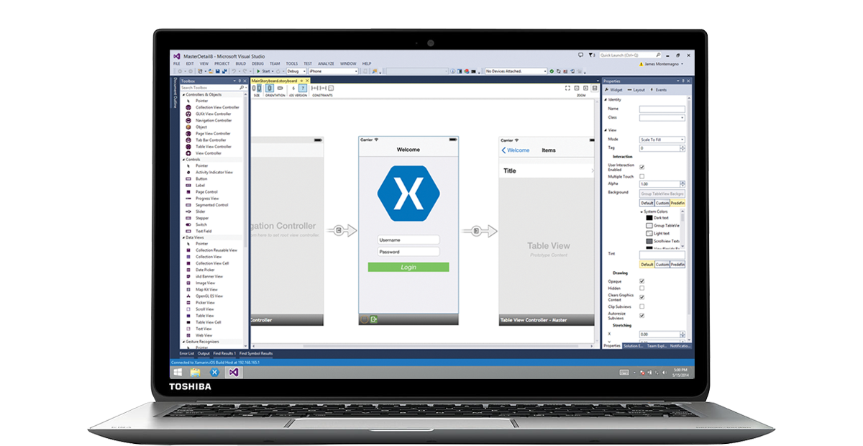
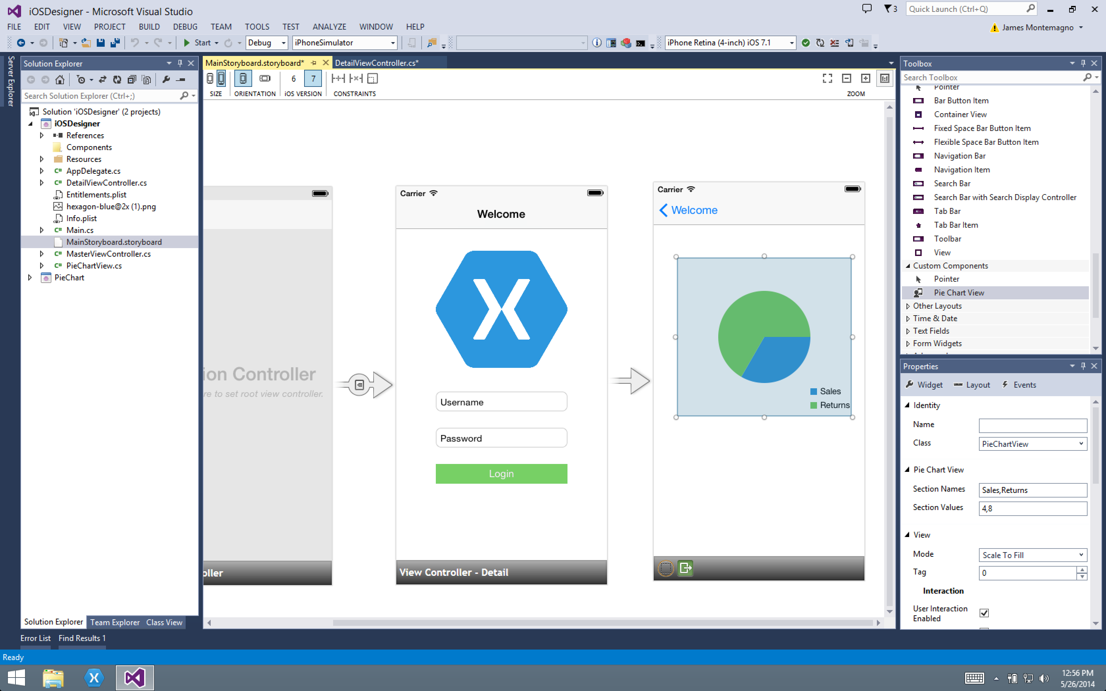
Xamarin Designer for iOS
Notes:
Short video of designer in action. You are able to use Xamarin Studio or Visual Studio for all of your development.

Slide 10
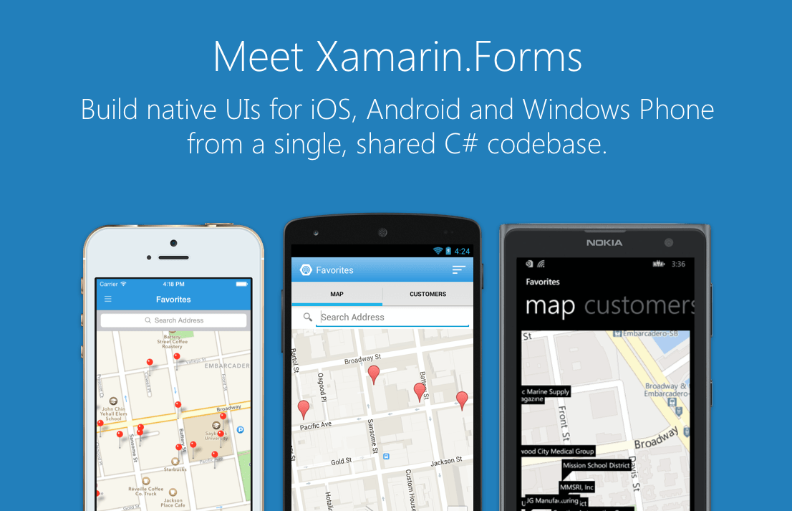
Portable Class Libraries
Notes:
Xamarin Forms is a new set of APIs allowing you to quickly and easily write shared User Interface code that is still rendered natively on each platform, while still providing direct access to the underlying SDKs if you need it.

Slide 11
Xamarin + Xamarin.Forms
With Xamarin.Forms:
more code-sharing, native controls
Traditional Xamarin approach
Shared UI Code
Notes:
We see here the Xamarin approach we talked about earlier
This enables you to be highly productive, share code, but build out UI on each platform and access platform APIs
With Xamarin.Forms you now have a nice Shared UI Code layer, but still access to platform APIs
You can start from native, pick a few screens, or start with forms, and replace with native later

Slide 12
What’s Included
40+ Pages, Layouts, and Controls
Build from code behind or XAML
Two-way Data Binding
Navigation
Animation API
Dependency Service
Messaging Center
Shared UI Code

Slide 13
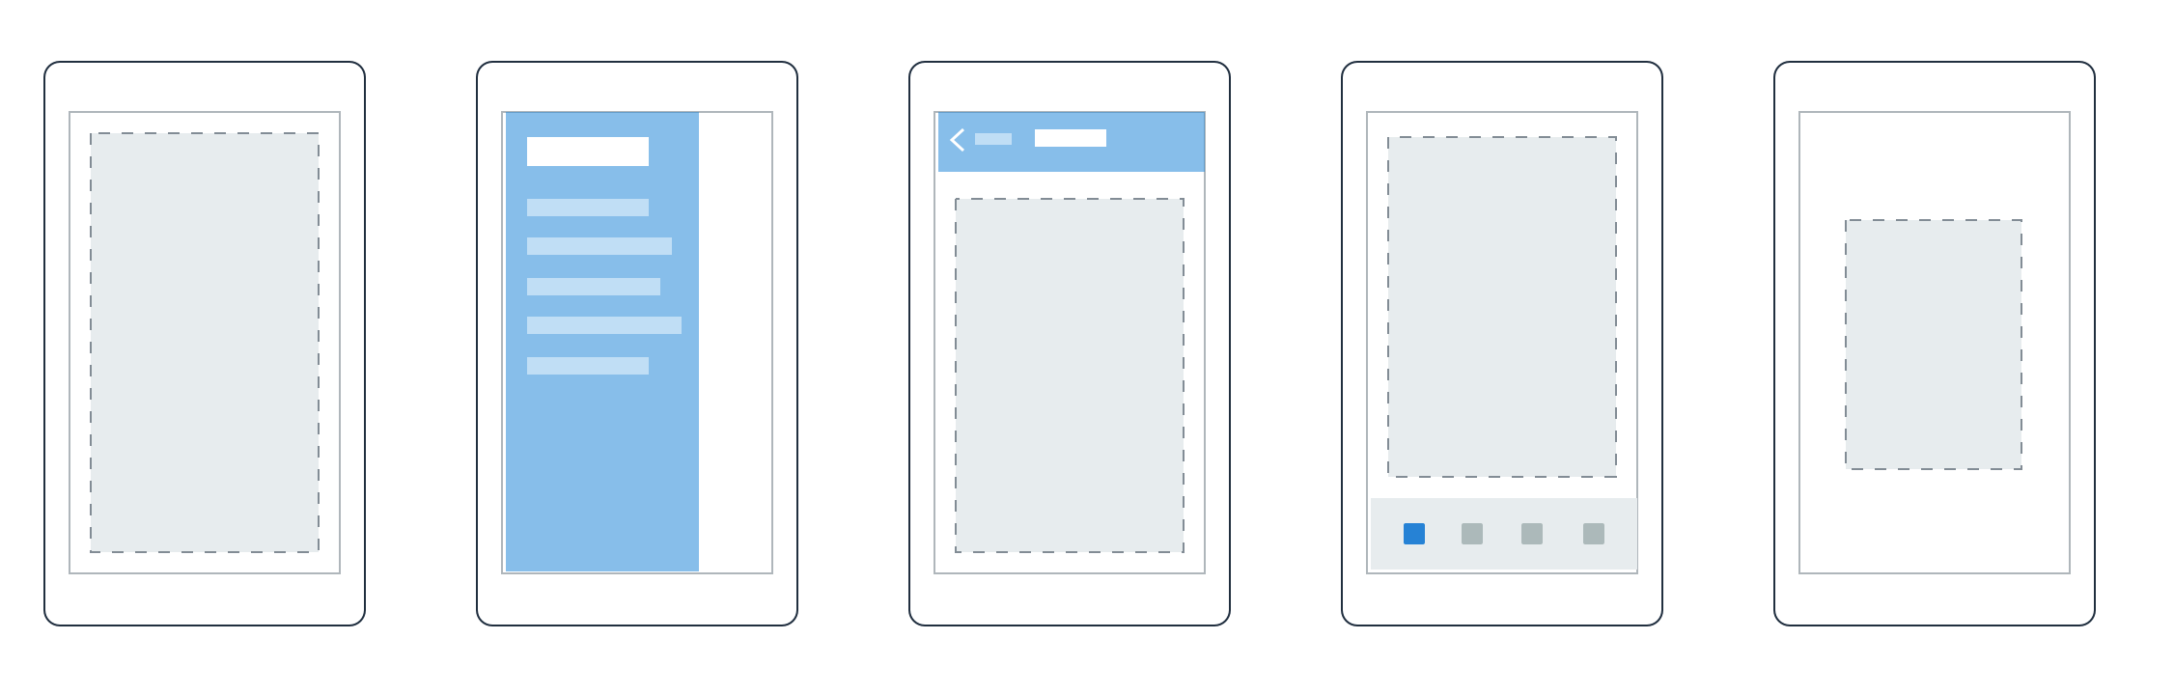

Pages
Content
MasterDetail
Navigation
Tabbed
Carousel
Notes:
First you have a set of pages for each screen of your application
There are things like Content, and MasterDetail which gives you a nice flyout
With a tabbed view you get the correct look on each platform
iOS on bottom, Android on top, and on WP you have a Pivot control

Slide 14
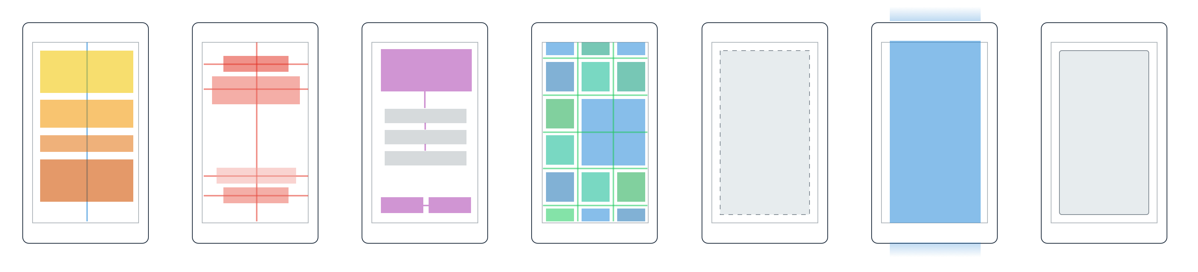
Layouts
Stack
Absolute
Relative
Grid
ContentView
ScrollView
Frame
Notes:
Inside of a page are layouts
A lot of options from something simple like a stack panel to complex and powerful grids

Slide 15
Controls
ActivityIndicator
BoxView
Button
DatePicker
Editor
Entry
Image
Label
ListView
Map
OpenGLView
Picker
ProgressBar
SearchBar
Slider
Stepper
TableView
TimePicker
WebView
EntryCell
ImageCell
SwitchCell
TextCell
ViewCell
Notes:
You have more than 40 controls, layouts, and pages to mix and match from.
These are all of the controls you have out of the box, you can of course create your own.
What is unique is you get the native control and have access to it.
Consider an Entry Field
On iOS it is mapped to UITextField
Android it is EditText
Windows Phoneit is a TextBox

Slide 16
DEMO 1 Displaying List of Data
Notes:
Let’s take a look at getting started with Xamarin.Forms and displaying some data across all platforms.

Slide 17
Model-View-ViewModel
Data
View
ViewModel
Data
Model
Events
How to display information
What to display
Flow of interaction
Business Logic
Data objects
Notes:
Xamarin.Forms was build with MVVM in mind. It is optional, but if you are used to an MVVM style of programming you are going to feel right at home.
MVVM is an architectural pattern that is used to abstract our Views/Pages from our Business Logic
Let’s look how it works.
Our View just knows how to display Information
It can pass data and event back and forth to the ViewModel
The ViewModel simply tells the View what to display and can accept events.
The model sits off to the side and only our ViewModel interact with it to gather data (maybe from the database or REST services)

Slide 18
Model-View-ViewModel
Data
View
ViewModel
Model
Events
Xamarin.Forms Data Binding
Notes:
The “Magic” of MVVM is with a Data Binding framework. This allows us to change data in the ViewModel and our View automatically reacts.
This is build into WPF/Windows Phone/Windows Store, but does not exist for Android or iOS.
However, Xamarin.Forms has a full data binding framework built right in. Let’s take a look.
----- Meeting Notes (1/22/15 10:11) -----
Important to note here is that if you have a WPF application that is written in MVVM then you can bring in the ViewModel and Model directly into Xamarin.Forms for reuse. Powerful stuff. Should demo this.

Slide 19
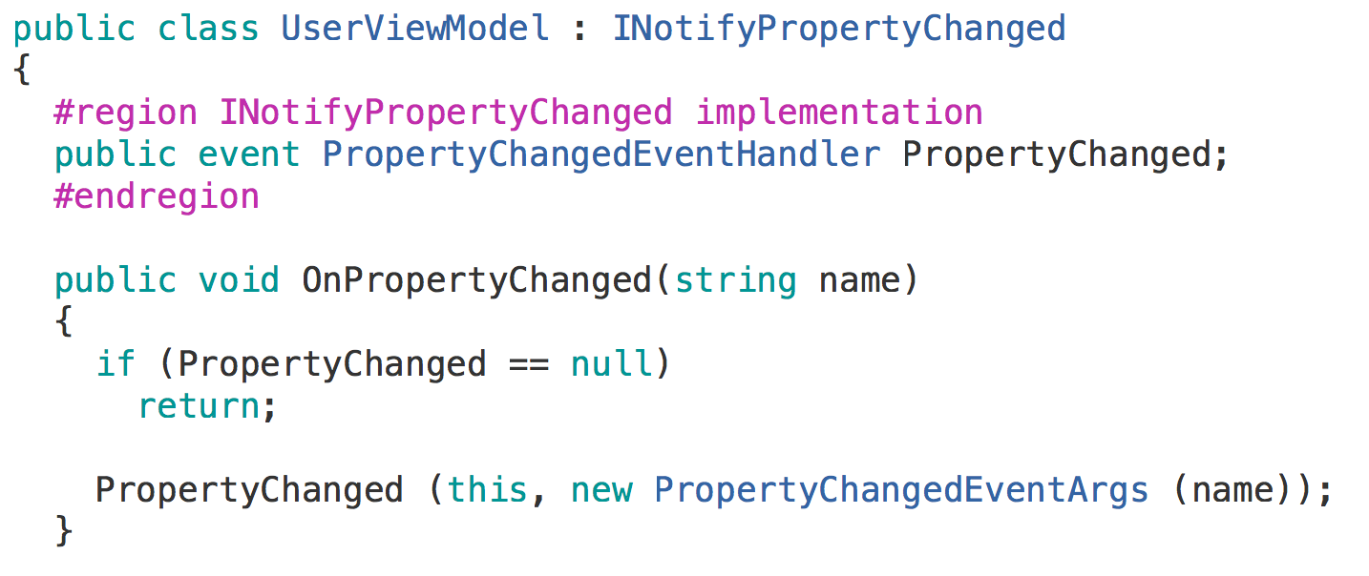
Data Binding
Notes:
The core of data binding comes with “INotifyPropertyChanged” This allows any UI element to subscribe and “Bind” to a property and react when the “PropertyChanged” method is raised.

Slide 20
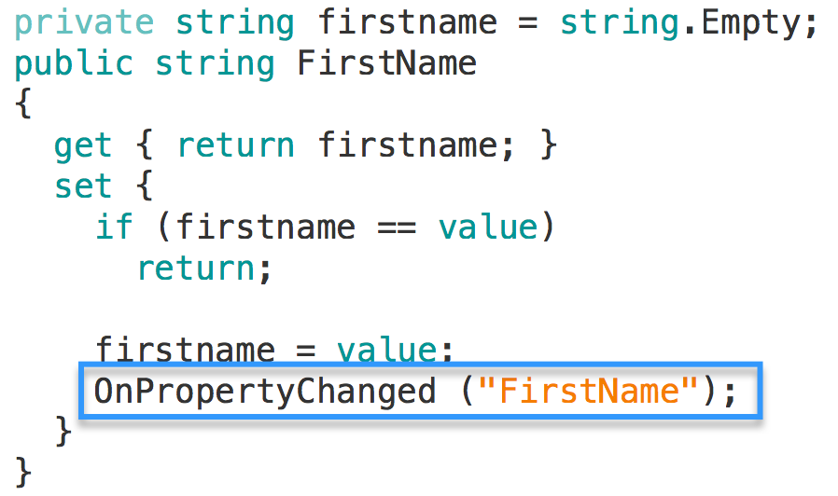
Data Binding
Notes:
When we update a field such as FirstName we trigger a property changed and anyone subscribed gets notified.

Slide 21

Data Binding
Notes:
Here we are creating a label and the “TextProperty” is being bound to the “FirstName” property in the ViewModel.

Slide 22

Data Binding
Notes:
We can also setup 2 way data binding so if our view update so does our ViewModel and vise versa.

Slide 23
DEMO Xamarin.Forms
Notes:
Let’s take a look at getting started with Xamarin.Forms and displaying some data across all platforms.

Slide 24
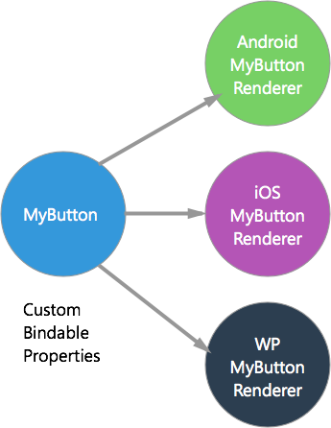
Extensibility
Custom Renderer
Easily subclass any control you wish to customize.
Add your own custom controls.
Add custom bindable properties
http://developer.xamarin.com/guides/cross-platform/xamarin-forms/custom-renderer/
Notes:
The extensibility framework in Xamarin.Forms enables us to
1.) Customize any of the built in controls
2.) Use any custom control that we might have developed

Slide 25
Extensibility
Dependency Service
Lets shared code access platform-specific SDK features via an Interface implementation

Slide 26
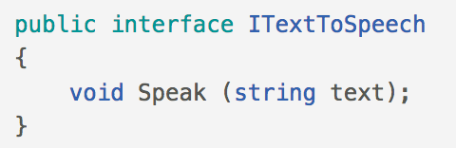
Extensibility
Step 1: Interface
Notes:
First step for using the the Dependency service is to setup an Interface that is accessible from your shared code.

Slide 27
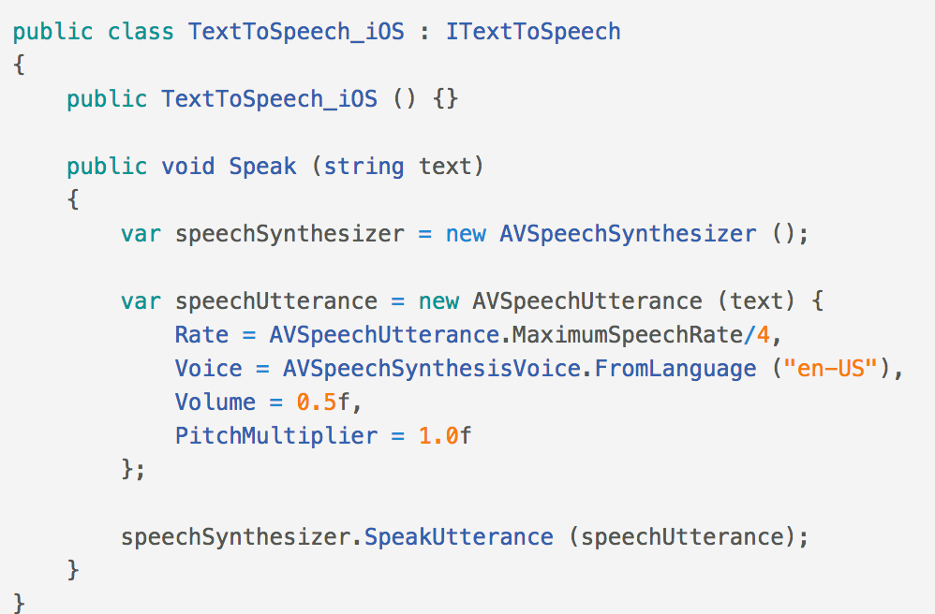
Extensibility
Step 2: Implement on each Platform
Notes:
For each platform we plan to support (iOS, Android, and Windows Phone), we will implement the native functionality. For instance here, we are using AVSpeechSynthesizer on iOS to perform TextToSpeech

Slide 28

Extensibility
Step 3: Register with Dependency Service
Notes:
The built in dependency service uses an assembly attribute to know what class to use for the interface implementation.

Slide 29
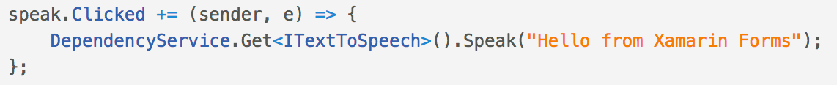
Extensibility
Step 4: Access from shared code
Notes:
The dependency service allows you to easily resolve your interface for the platform specific implementation. Here we are playing back “Hello from Xamarin Forms” when we click a button.

Slide 30
Navigation
Root Page:
NavigationPage – Gives each page an INavigation
Standard Navigation
Navigation.PushAsync(page: nextPage);
Navigation.PopAsync();
Modal Navigation
Navigation.PushModalAsync(page: modalPage);
Navigation.PopModalAsync();

Slide 31
Animations API

Slide 32
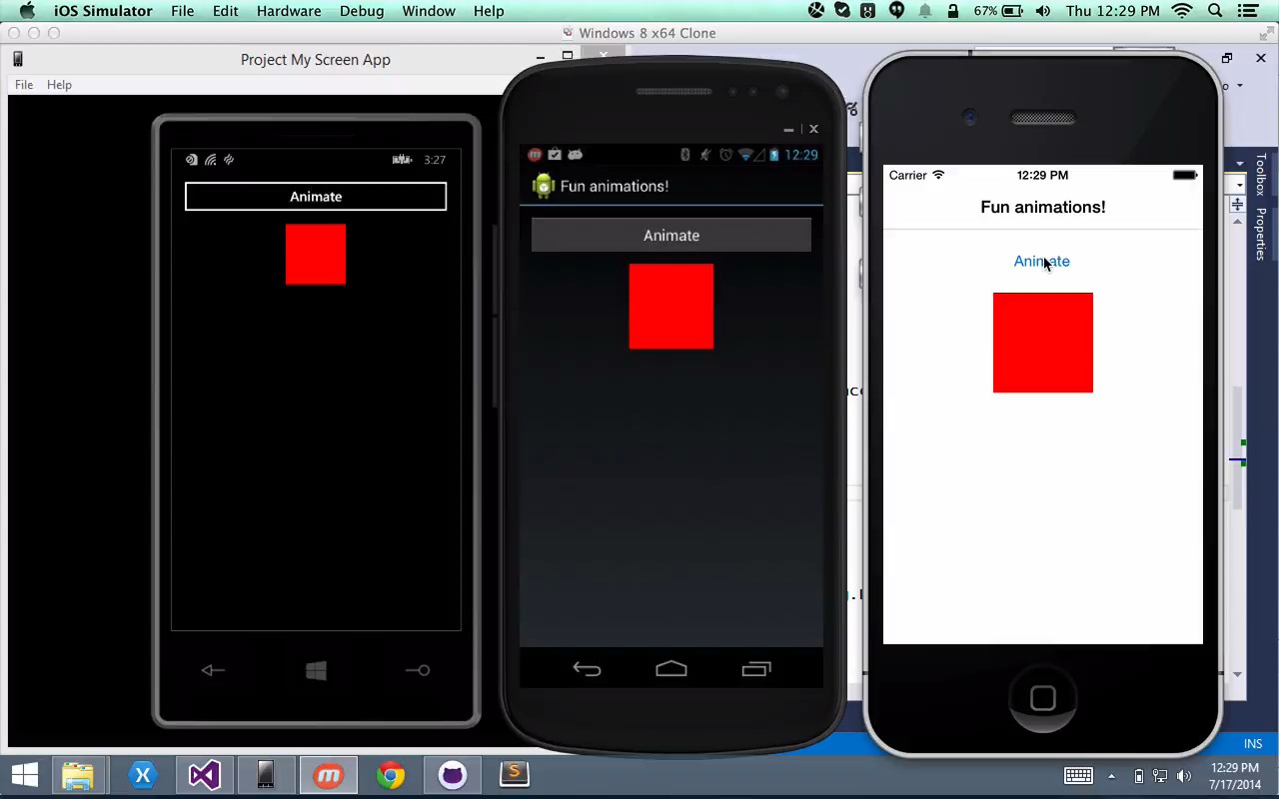
www.github.com/JamesMontemagno/FormsAnimations
Notes:
Xamarin.Forms has a complete cross platform animations api as well. It takes advantage of the underlying APIs on each platform such as CoreAnimation on iOS.
Additionally, it is completely asynchronous with an async/await api.

Slide 33
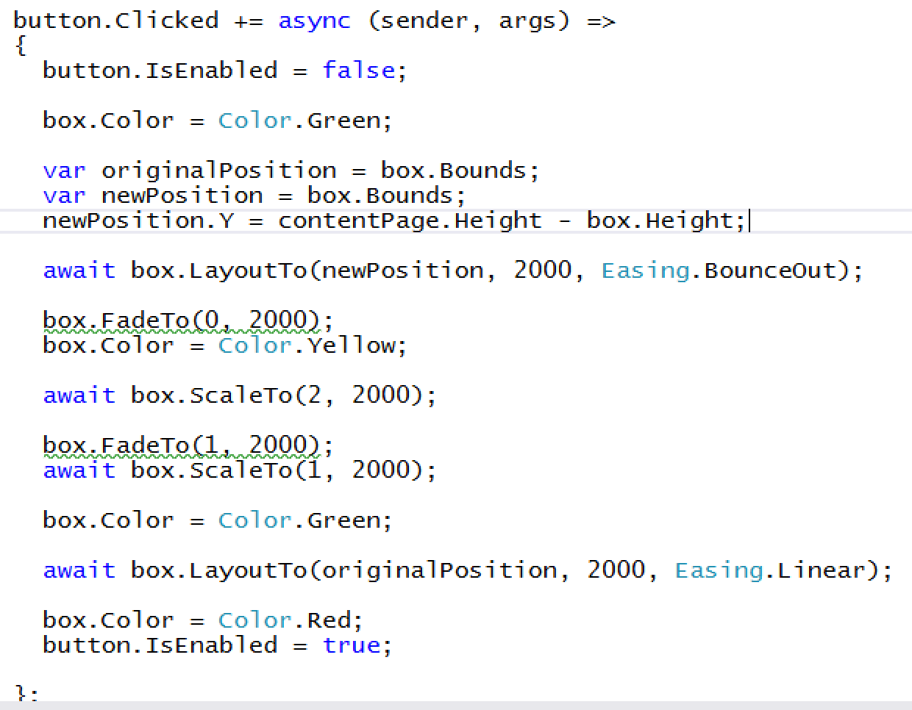
Notes:
Here we can see we have our event for the button click.
We first disable the button and set the box to Green.
We save out the location and set a new location to drop to the bottom of the page and bounce.

Slide 34
Notes:
We await for that to finish and start to fade out the box, change the color to yellow.
Then we scale the box up, wait for that to finish and scale it back down.

Slide 35
Notes:
After that is completed we move it back to the original position linearly.
After that completes we set the box back to red and enable our button again.
Let’s see what it looks like one more time.

Slide 36
www.github.com/JamesMontemagno/FormsAnimations

Slide 37
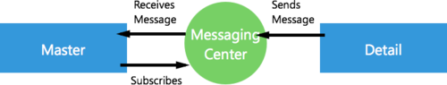
Messaging Center
MessagingCenter.Subscribe<T>(object subscriber, string message, Action<T> callback);
MessagingCenter.Send(T item, string message);

Slide 38
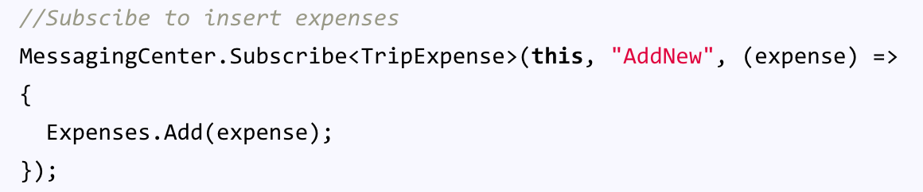

Messaging Center
Master Page:
Detail Page:

Slide 39
Resources
Documentation
http://developer.xamarin.com/guides/cross-platform/xamarin-forms/
XAML Documentation
http://developer.xamarin.com/guides/cross-platform/xamarin-forms/xaml-for-xamarin-forms/
Samples
https://github.com/xamarin/xamarin-forms-samples

Slide 40
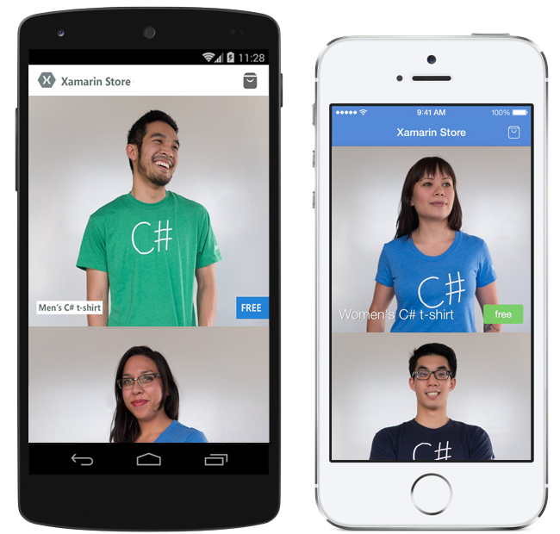
Barkley Hughes
Presenter Website
Barkley.Hughes@csiweb.com
@carlowahlstedt
Presenter Website
carlowahlstedt@gmail.com
Q & A
Get your free C# t-shirt:
xamarin.com/shirt

